Slide 1



Power BI Financial Data Analysis

Slide 2

Learning Objectives
Understanding data cleaning techniques in Power BI.
Creating meaningful data visualizations and insights.
Applying DAX functions for analysis.
Using Power Query for transformation.
GOAL
Insightful Analysis
Source :
www.freepik.com/

Slide 3
Tools and Technology used
Power BI
DAX
Power Query
Excel

Slide 4
Methodology
Data Cleaning:
Checked for missing values and handled them appropriately.
Removed duplicate entries.
Ensured correct data types (e.g., numerical, date, text).
Fixed inconsistencies in categorical data.
Identified and handled outliers.
Data Analysis & Visualization:
Created multiple charts and visualizations to extract insights.
Applied filters and sorting to enhance data presentation.
DAX & Calculations:
Created calculated columns for Month Number.
Used DAX measures to calculate KPIs.

Slide 5
Problem Statement:
Businesses often struggle with making data-driven decisions due to unstructured financial data. The goal is to analyze financial performance across products, countries, and time periods using Power BI.

Slide 6
Solution:
Total Units Sold by Each Product – Bar Chart
Total Gross Sales by Each Country – Bar Chart
Total Profit by Each Month – Line Chart (Sorted Month Name by Month Number)
Average Manufacturing Price of Each Product – Donut Chart
Total Profit by Each Segment – Pie Chart
Top 5 Profitable Products – Bar Chart (Applied Top N Filter)
Country-wise Units Sold – Map Visualization
Card Charts:
(i). Avg Sales Price
(ii). Avg Manufacturing Price
(iii). Total COGS
(iv). Total Profit
Sales Trend Over Time – Area Chart
Profit by Product Category – Stacked Column Chart

Slide 7
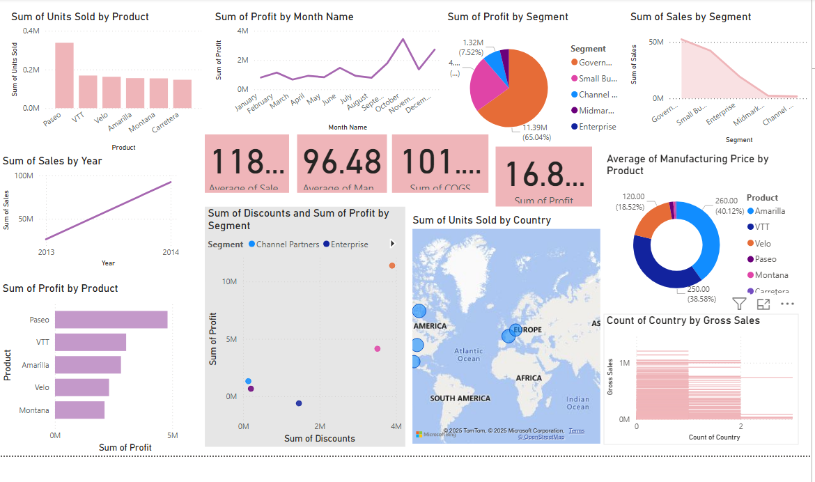
Screenshot of Output:

Slide 8
Conclusion:
The analysis provided insights into sales trends, profitability, and segment performance.
Power BI enabled efficient data cleaning, transformation, and visualization.
The final dashboard allows for dynamic filtering and deeper financial insights for business decisions.

